Slide 1

Web Application architecture – an overview
Programming Applications And Frameworks (It3030)

Slide 2
Learning outcomes
After completing this lecture, you will be able to,
Describe the main components of three tier architecture for web development.
Identify some suitable technologies to develop the presentation layer and the application layer of a web application.
Apply suitable architectural components to design the presentation layer and the application layer of a Three tier web application.

Slide 3
Contents
Website vs Web Application
Three Tier/ Three Layer Architecture
Presentation Layer
Some technologies
Architecting the Presentation Layer
Application Layer
Some technologies
Application Programming Interface (API)
Architecting the Application Layer
Big Ball of Mud: an architectural anti-pattern
Other Helpful Technologies
Summary

Slide 4
Website vs. Web Application
Q: What is the difference between a Website and a Web Application?
A Website provides static content which can be consumed by the end users.
A Web Application is designed for interaction with the end users.
Our focus is on Web Applications.

Slide 5
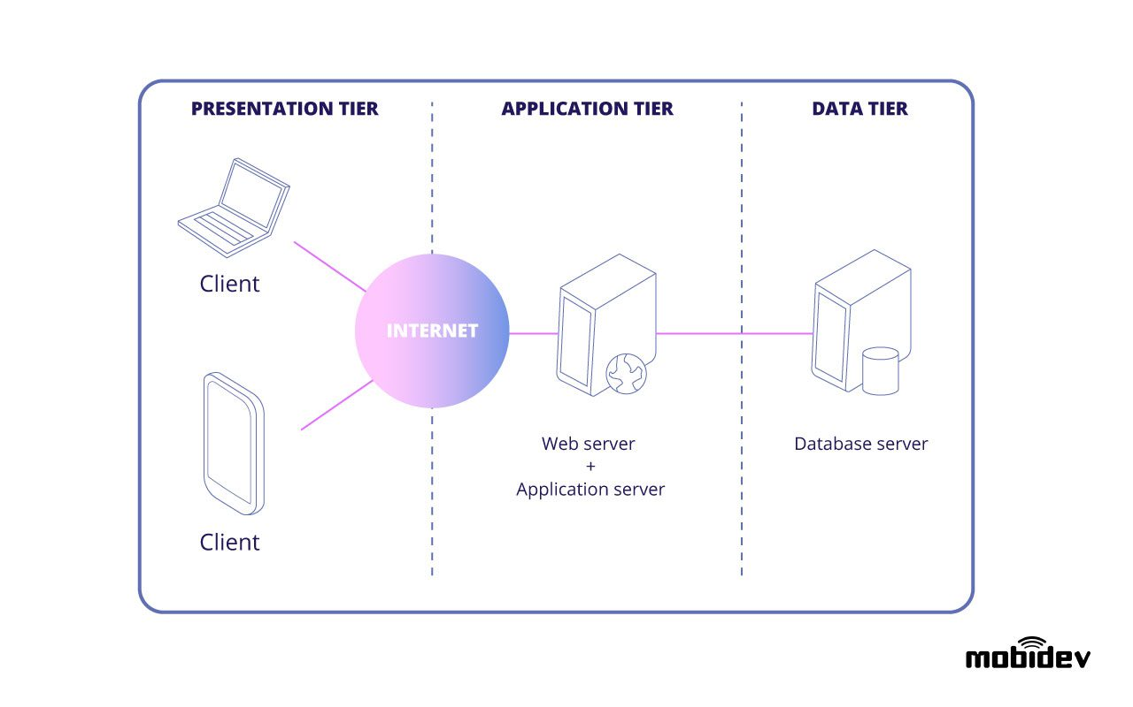
Three tier architecture
Source: https://mobidev.biz/blog/web-application-architecture-types

Slide 6
Three tier architecture
Modern web applications are engineered based on this architecture.
Has three tiers.
Presentation tier/ layer
Application tier/ layer
Database tier/ layer
The most popular form of n-tier (multitier) architecture.

Slide 7
Three tier architecture
Three tier architecture is a good choice for the development of web applications.
Reasons?
Each tier/ layer runs on its own infrastructure.
Each tier/ layer can be developed independently/ in parallel by different teams.
Allows updating and scaling up/ down each tier independently without impacting the other tiers.
Better security when compared with two tier architecture (due to the isolation of data and logic from the presentation tier).

Slide 8
Presentation layer
Also called the client side or the frontend.
Technologies used to implement include,
HTML/ CSS/ JavaScript
React.js
Angular
Vue.js
Some legacy technologies
jQuery and AJAX

Slide 9
Architecting the Presentation Layer
Some well known examples
Model-view-controller (MVC)
Model-view-viewmodel (MVVM)
Some more examples
Model-view-presenter (MVP)
Component Architecture
Micro frontends

Slide 10
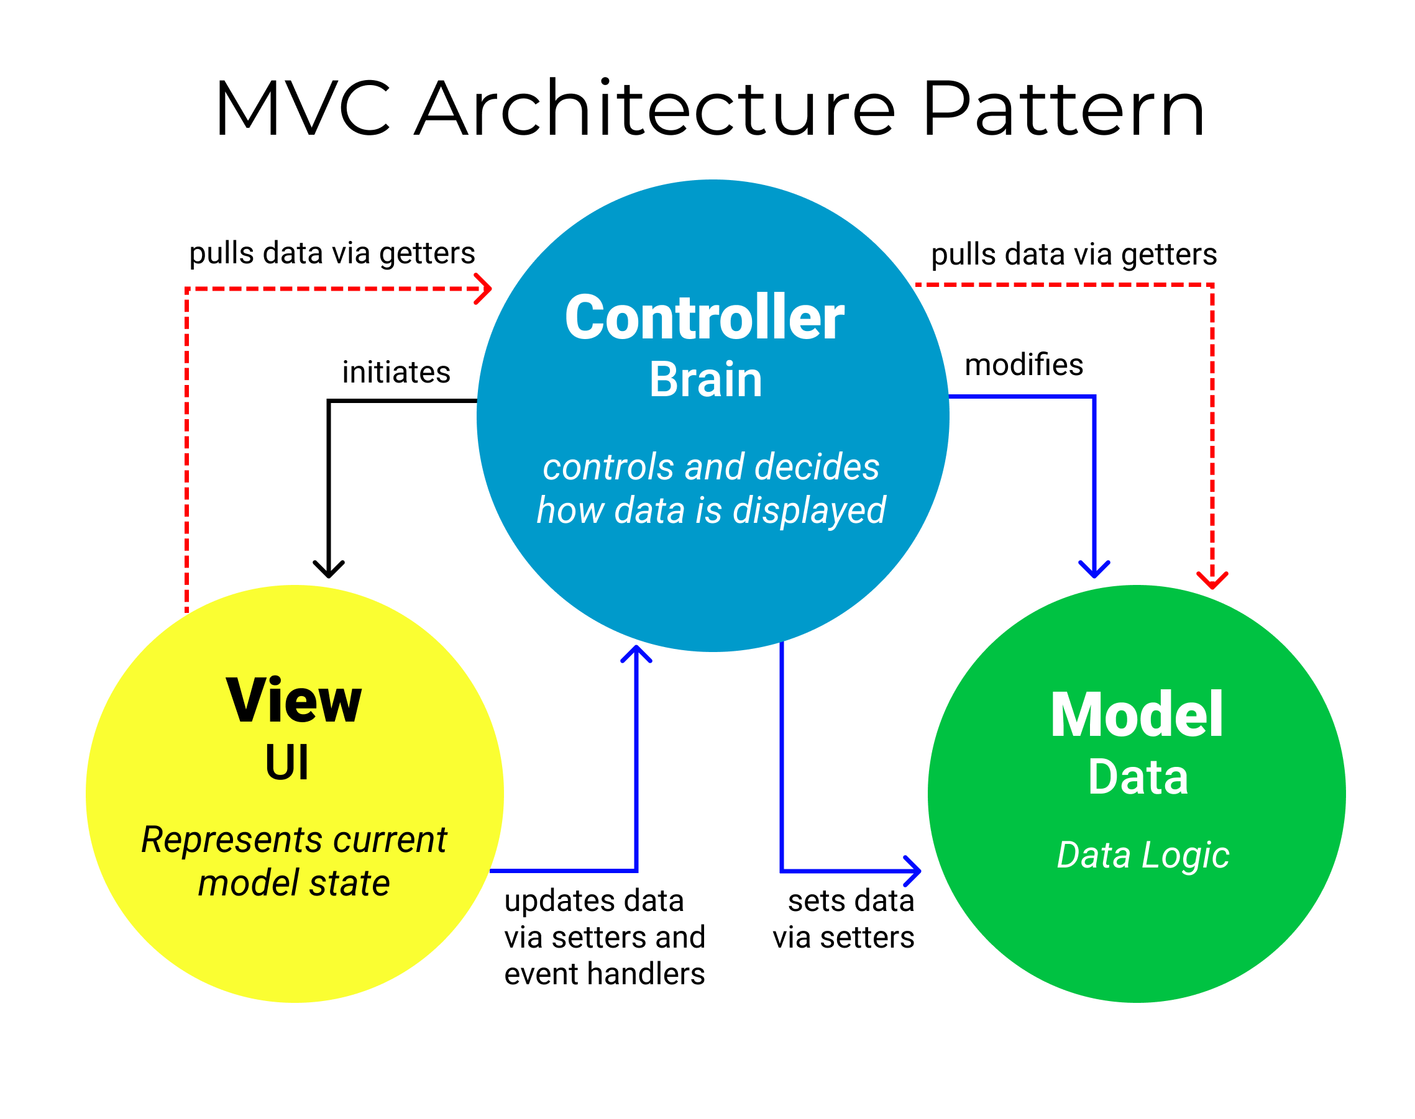
Architecting the Presentation Layer: MVC
Source: https://www.freecodecamp.org/news/the-model-view-controller-pattern-mvc-architecture-and-frameworks-explained/

Slide 11
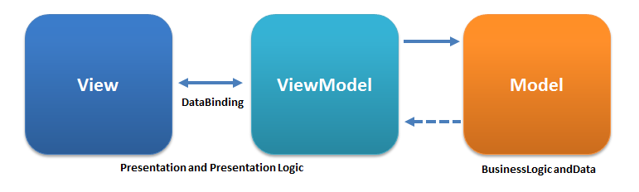
Architecting the Presentation Layer: MVVM
Source: https://en.wikipedia.org/wiki/Model%E2%80%93view%E2%80%93viewmodel

Slide 12
Application Layer
Also called the server side or the backend.
Technologies used to implement include but not limited to,
Programming languages and frameworks
Java (frameworks: Spring/ Spring Boot)
Node.js (frameworks: express.js/ Koa)
Python (frameworks: Django/ Flask)
PHP (frameworks: Laravel, Symphony)
.Net Framework
Virtual Machines (VMs)
Serverless Computing
Containers

Slide 13
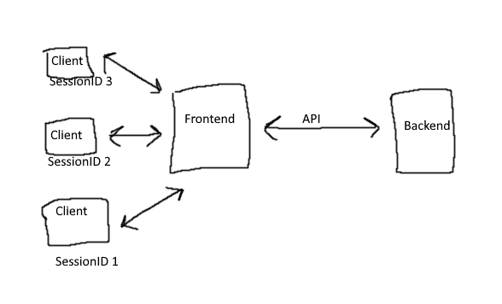
Application Layer
How does the Backend and the frontend communicate?
Source: https://stackoverflow.com/q/71033687

Slide 14
Application Layer: APIs
Application Programming Interface (API)!
What is it?
A software interface which facilitates communication between two or more applications.
Abstracts away the complexities of application integrations.
A contract of services offered.

Slide 15
Application Layer: APIs
Benefits of APIs?
developers don’t have to create everything from scratch - can use existing functions exposed as an API resulting in more productivity.
APIs significantly reduce development costs by reducing development efforts.
Improves collaboration and connectivity across the ecosystem.

Slide 16
Application Layer: APIs
Different types of APIs?
Representational State Transfer API (REST API)
Simple Object Access Protocol API (SOAP API)
More on these in a separate lecture.

Slide 17
Architecting the Application Layer
Some well known examples
Monolithic Architecture
Microservices Architecture

Slide 18
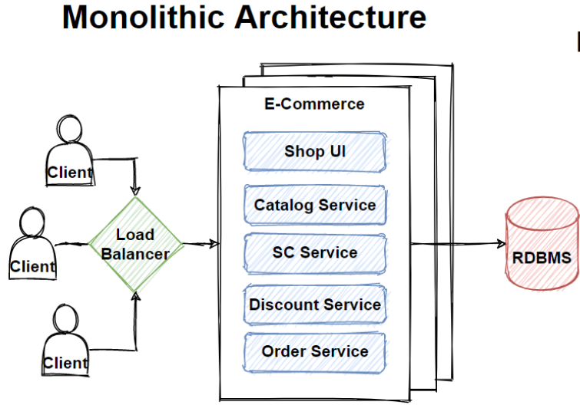
Architecting the Application Layer: Monolithic
Source: https://medium.com/design-microservices-architecture-with-patterns/monolithic-architecture-is-still-worth-at-2021-98bfc112dc24

Slide 19
Architecting the Application Layer: Monolithic
Drawbacks in Monolithic Architecture?
Slower development speed due to local complexity.
Can’t scale individual components.
Reliability – if there’s an error in any module, it could affect the entire application’s availability.
Barrier to technology adoption – any changes in the framework or language affects the entire application, making changes often expensive and time-consuming.
Lack of flexibility – a monolith is constrained by the technologies already used in the monolith.
A small change to a monolithic application requires the redeployment of the entire monolith.

Slide 20
Architecting the Application Layer: Microservices
“Microservices architecture is an approach in which a single application is composed of many loosely coupled and independently deployable smaller services.” (Source – IBM)

Slide 21
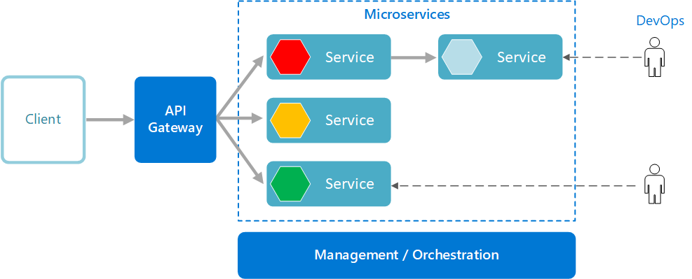
Architecting the Application Layer: Microservices
Source: https://learn.microsoft.com/en-us/azure/architecture/guide/architecture-styles/microservices

Slide 22
Architecting the Application Layer: Microservices
Some benefits of Microservices
Microservices are small, independent, and loosely coupled (therefore, a single team can write/ maintain a single service).
Services can be deployed independently (can update an existing service without rebuilding/ redeploying the entire application).
Can scale each service independently
High reliability
Supports polyglot programming

Slide 23
Architecting the Application Layer: Microservices
Is everything great with Microservices?

Slide 24
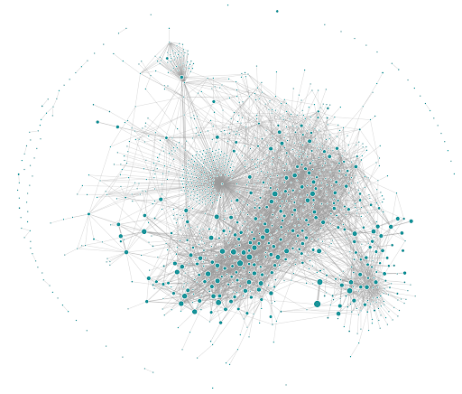
Architecting the Application Layer: Microservices
Uber’s microservice architecture circa mid-2018
Source: https://www.uber.com/en-LK/blog/microservice-architecture/

Slide 25
Architecting the Application Layer: Microservices
High global complexity is the biggest problem when in comes to Microservices.
Local complexity depends on the implementation of a service; global complexity is defined by the interactions and dependencies between the services.
Managing complexity is a constant challenge in Microservices.

Slide 26
Architecting the Application Layer: Microservices
What are some other downsides of Microservices?
High infrastructure costs
Debugging challenges
A lot more…

Slide 27
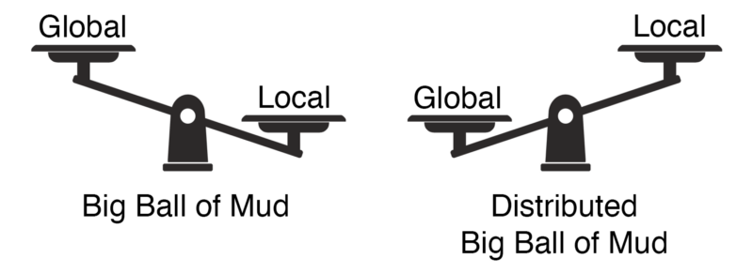
Big Ball of Mud: an architectural anti-pattern
Source: https://www.doit.com/untangling-microservices-or-balancing-complexity-in-distributed-systems/

Slide 28
Other helpful technologies
API Gateways (authentication, throttling, orchestration, caching, statistics etc.)
Content Delivery Networks (CDN)
Caching Tools (e.g., Redis)
Load Balancers
Message Queues
Cloud Computing
Cloud Storage
Virtual Machines (VMs)
Many more resources…

Slide 29
Some interesting topics
Component Based Architecture
Micro Frontends – Microservices for the frontend
BFF: Backend For Frontend also known as BIF: Backend In Frontend

Slide 30
References
Web application vs. website: finally answered
What is three-tier architecture?
SOAP APIs vs REST APIs
Micro Frontends: What are They and When to Use Them?
Model–view–presenter
An In-Depth Guide to Component-Based Architecture: Features, Benefits, and more
The Complete Guide To BFF (Backend For Frontend)
Microservices vs. monolithic architecture
Untangling Microservices or Balancing Complexity in Distributed Systems
Big Ball of Mud - The Daily Software Anti-Pattern

Slide 31

Thank You
Vishan.j@sliit.lk
nelum.a@sliit.lk

